Slide 1
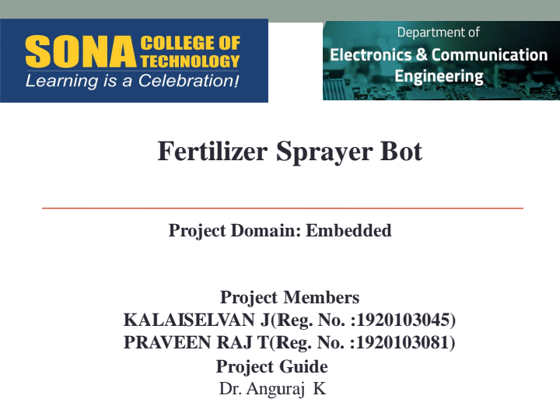
TITLE OF PROJECT: Microplastic detection in water using low cost sensors
NAME : Priethwin R (61782324103123)
Andhakumar S (61782324103006)
GUIDE : Asst prof Dr.M.Hema Kumar

Slide 2
INTRODUCTION:
The presence of microplastics in water is an increasing environmental and public health concern.
Microplastics are very small and difficult to detect through conventional visual inspection methods.
Existing laboratory-based detection techniques can be expensive, time-consuming, and require specialized equipment.
There is a need for a low-cost, portable, and rapid preliminary detection system for water samples.

Slide 3
OBJECTIVE:
To develop a low-cost and portable system for the preliminary detection of microplastics in water.
To use IR optical sensing to detect suspended particles in the water sample.
To measure water turbidity and analyze the sensor readings using an ESP32
To display the detection results on an LED display and provide an alert when required.
To enable wireless monitoring and data collection for effective water quality assessment.

Slide 4
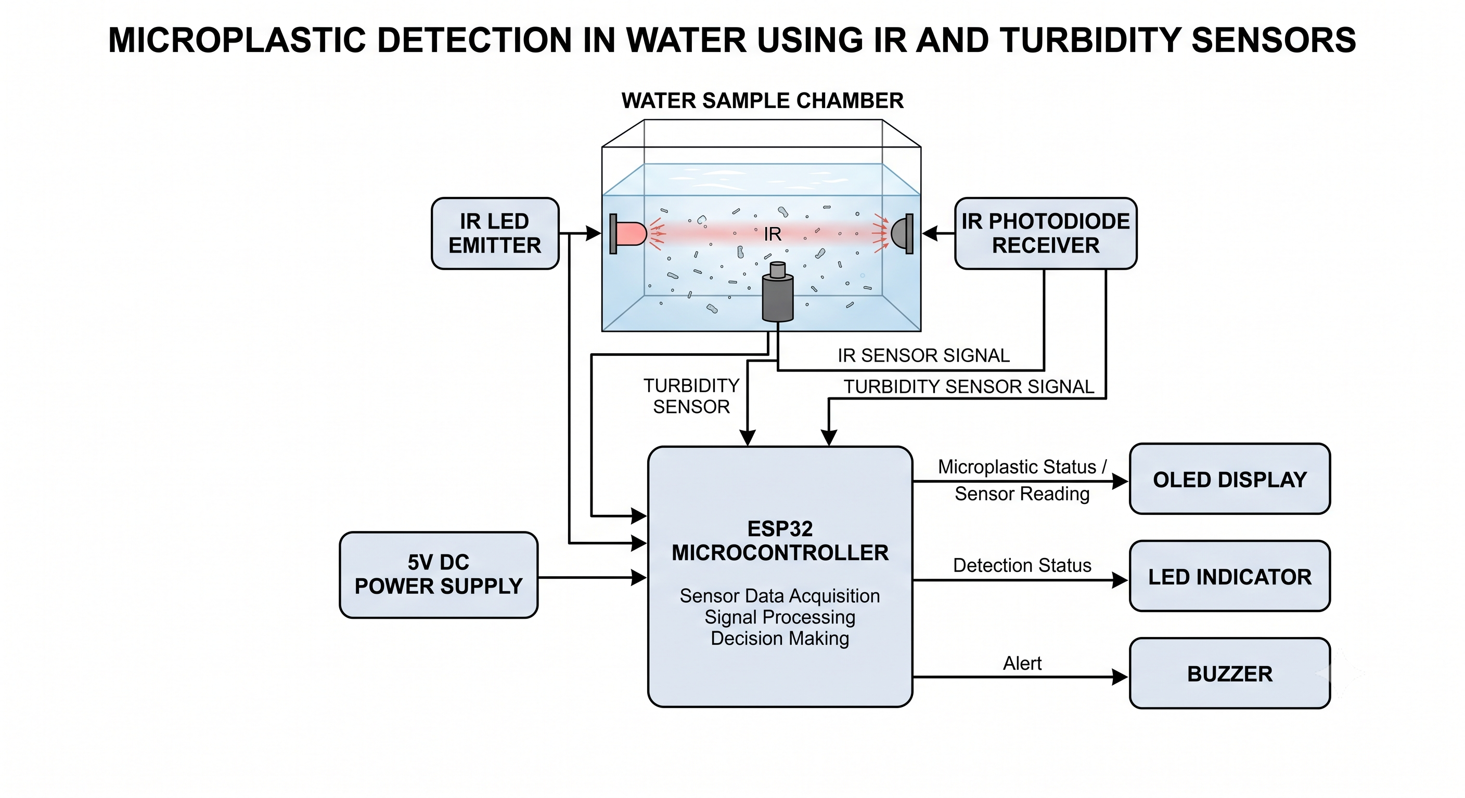

Slide 5
Working Principle:
The water sample enters the sample chamber containing the sensing arrangement.
The IR LED emits infrared light through the water sample.
The IR photodiode detects changes in the received light intensity caused by suspended particles.
The turbidity sensor measures the turbidity level of the water sample.
The ESP32 collects and processes both sensor signals using predefined threshold values.
The system determines the preliminary presence of possible microplastic particles based on the sensor readings.
The LED display shows the sensor values and detection status, while the LED/buzzer provides an alert when required.
The ESP32 can transmit the sensor data through Wi-Fi for optional remote monitoring.

Slide 6
COMPONENTS | DETAILS IN ONE LINE | QTY | PURPOSE
sensors | IR LED + IR photodiode + turbidity sensor | 1 set | Detect optical changes and suspended particles in the water sample
Key switches | Push button switch for starting/resetting the detection process | 1 | User control for the system
Display | 0.96-inch LED/OLED display | 1 | Display microplastic detection status and sensor readings
Interface | ESP32 development board | 1 | Processes sensor signals and controls the system
Wireless connectivity | ESP32 built-in Wi-Fi/Bluetooth | 1 | Enables wireless transmission of detection data
Cloud connectivity | Blynk via ESP32 Wi-Fi | 1 | Store and monitor sensor readings remotely

